Slide 1
Chatbot for COVID-19
Mitigating COVID-19 Concerns
Jaydutt Joshi
Keith Frank
Ronak Kumar
Sourabh Potdar
Yash Shah

Slide 2

Introduction
The COVID-19 pandemic has raised a lot of questions amongst the general population, which are answered in a different way by different sources of media.
Chatbots are the latest inventions utilized to combat the novel SARS-CoV-2 coronavirus COVID-19 that enable users to communicate and interact with software applications that can intelligently respond to frequently asked questions using AI based tools
We built a bot that tries to understand user concerns and answers them with the most accurate information available from knowledge sources
Notes:
Coronavirus a.k.a COVID-19 is a viral contagious disease caused by the severe acute respiratory syndrome SARS-CoV-2
Symptoms of COVID‑19 vary but prominent ones include fever, cough, headache, fatigue, breathing difficulties, loss of smell and taste
Artificial intelligence (AI) based conversational agents commonly known as
Our aim is to build a chatbot expert system which can identify the intent of the input message and respond to COVID-19 user-queries and frequently asked questions including extracting information about the symptoms, available vaccines in the market, transmission of the disease, the role of climate in its spread and finally any particular kind of food items to reduce the extremity level of the disease

Slide 3
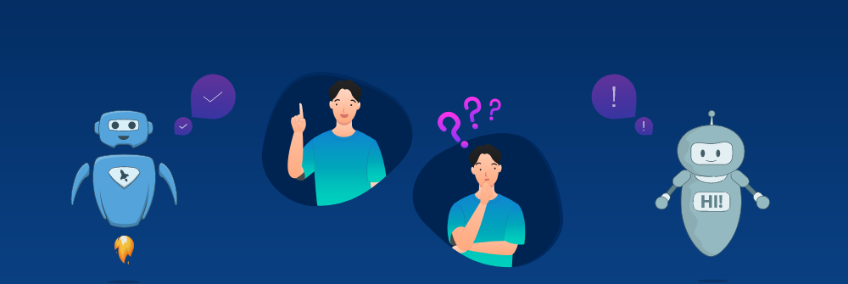
Task and Purpose of the Expert System
Chatbots are computer programs designed to conduct textual or audible conversations with a single user.
The texts are often extremely context-dependent and ambiguous, especially in multi-person conversations across multiple topics.
Task-oriented chat-bots operate by detecting the intent of the user for each request and providing a response based on the intent.

Slide 4
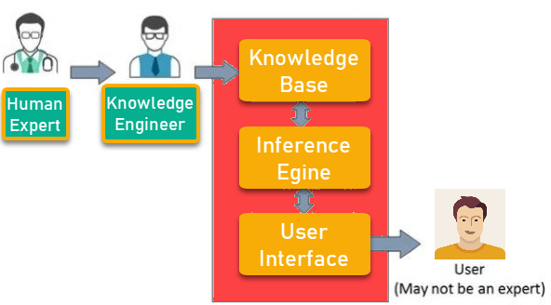
Task and Purpose of the Expert System
What is Expert System?
Expert System is an interactive and reliable computer-based decision-making system which uses both facts and heuristics to solve complex decision-making problems.
The Expert System in AI can resolve many issues which generally would require a human expert.
This chatbot is intent-based chatbots and they
operate by detecting the intent of the user for each request and providing a response based on the intent.
Components of Expert System:

Slide 5
Knowledge Sources & Knowledge Acquisition
Centers for Disease Control and Prevention. “Myths and Facts about COVID-19 Vaccines.” CDC, National Center for Immunization and Respiratory Diseases (NCIRD)
Government Of Canada. “Coronavirus disease (COVID-19) outbreak updates, symptoms, prevention, travel, preparation.” Canada.ca, Government Of Canada, 2020
Intermountain Healthcare. “Misconceptions about COVID-19”
Implementation of a Chatbot System using AI and NLP.

Slide 6
Knowledge Design & Engineering
Domain understanding: History of Covid-19 chatbots
Advantages of a chatbot in general and its relevance with respect to addressing queries related to Covid-19
Application of NLP and NLU in designing a Chatbot
Constraints and limitations of a chatbot
Intent-based contextual chatbot
Flow based approach

Slide 7
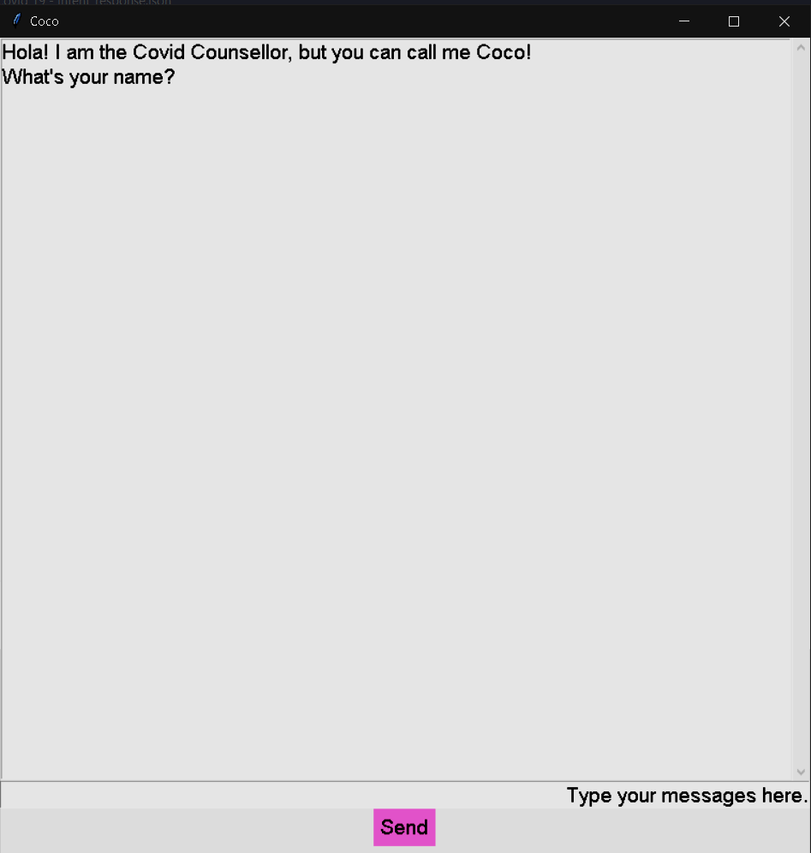
User Interface
The interaction between the user and the systems is a dialog that is basically user presented questions being answered by the system.
The user is first greeted by The COVID Chatbot asking for their name, to give the user a sense of familiarity. The user is then able to ask the data any question they want to know the answer to.
The system analyzes the statement given by the user and gives an estimated answer to the question. The question can be anything COVID-19 related as mentioned above.

Slide 8
Implementation
Tools:
Python
Tkinter
Sklearn
Spacy
NLTK
Dataset
We collected the data by asking our friends and family the common question regarding COVID-19. Then we collected some of the information from the links provided above.
Used spacy to embed the dataset
Training & Testing
We trained and tested the following classifiers:
GNB
Linear
KNN
SVM
User Interface
We used tkinter to develop the GUI for the user to be able to easily interact with the system.

Slide 9
Group Members Tasks
Member | Task | Time Elapsed
Sourabh Potdar | Model training | 1 day
Jaydutt Joshi | Resources Collection | 1 day
Keith Frank | GUI Development | 1 day
Ronak Kumar | Dataset Handling/Resource Interpretation | 1 day
Yash Shah | Testing Model & GUI | 1 day
Team | Documentation and drafting | 2 days
Team | Presentation slides | 1 day

Slide 10
Thanks

